Slide 1
Where2Meet
George, Jarrett, Trevor, and Isaac

Slide 2
Login Page
Create New Account
Create New Group
Create New Event
Personal Profile
Group Home Page
Event Page
Overview

Slide 3
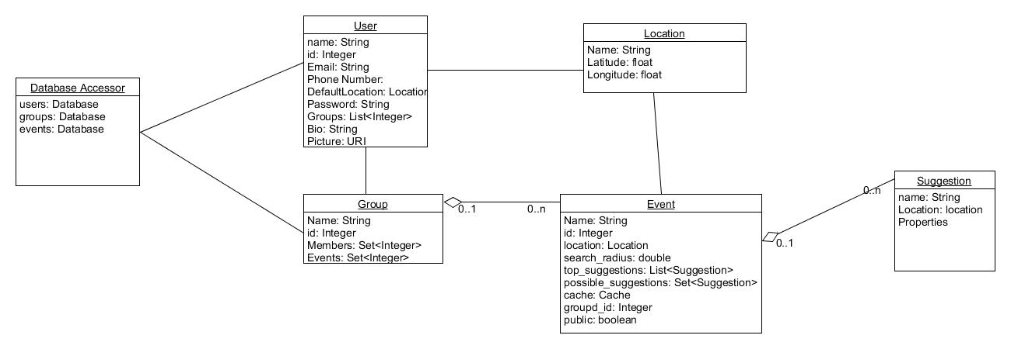
Containment Diagram

Slide 4
User data to store:
First name
(Optional) Last name
Email - used to hash unique user ID
(Optional) Phone number
(Optional) Location
Request current location or input default location
(Optional) Photo
(Optional) Bio
Users have the ability to create a new group

Slide 5
Group data to store
Group Name
Group Members
Each member links to a profile
List of events for the group
Ability for group members to create a new group

Slide 6
Event Creation
Group members can create a new event for the group
Prompt user to input the following:
Event Leader
Event Name
Purpose
Location
Given when created
Specified location, or
Average of group members’ locations
Time
Apply specific filters to generated results

Slide 7
Response to Events
View suggested locations and times for meeting
Vote on existing meeting locations or suggest new ones

Slide 8
Suggested location generation and ranking
Location-based
Within five-mile radius
Type of venue
Ex.
Restaurant
Movie Theatres
Parks
Etc
Individual users can apply filters to list of results

Slide 9
Tasks
Pages
Login/Signup page
User Profile page
Group Profile page
Group Event page
Google Maps Integration
Foursquare API
Mongo
Interface between frontend and backend
Ranking
User ranking
Suggestions ranking

Slide 10
Division of Labor
George:
Frontend Structure
Trevor:
Google Maps API
Ranking Suggestions
Front End/Back End Interface
Isaac:
Foursquare API
Mongo DB
Outlining Java Classes
Jarrett:
Foursquare API/Mongo DB
Suggestion generation
User/Group creation

Slide 11
Minimum functionality
Enables users to create accounts
Creates and stores groups of users
Search through events
Create and store events within groups
Generate suggestions within events
Search through events
Rank a list of suggestions according to search filters
Search through suggestions
Enable group voting for suggestions
Have a gui that reflects all above points

Slide 12
Additional Functionality
Messaging functionality
Enable cookies
Create polls in other apps
Ex.
FB Messenger
iMessage

Slide 13
April 1st
April 23rd
April 30th
May 4th
May 6-7th
Code Skeleton
Individual Components Done
Integration of Parts
Testing Complete
Demo Day
Timeline

